Slide 1
METABOLIC FUNCTIONS OF THE LIVER By Dr.Mahadevi A.L Assistant professor Dept of Paediatrics 16-08-2021

Slide 2
The liver is the second largest organ in the body and has a variety of important functions relating to metabolism and detoxification.

Slide 3
Carbohydrate Metabolism
The liver plays a central role in maintaining blood glucose levels.
Following consumption of food, excess glucose can be stored within the liver as glycogen. This is stimulated by insulin release. Around 100g of glycogen is stored in the liver (300g is stored in skeletal muscle). This glycogen can then be degraded to release glucose in times of exercise (skeletal muscle stores) or fasting (liver stores).
It is important to note that it is not a direct reversal of synthesis.

Slide 4
The steps of glycogenolysis are as follows:
One residue of glycogen is removed and converted to glucose-1-P by glycogen phosphorylase or de-branching enzyme
Glucose-1-P is converted to Glucose-6-P by phosphoglucomutase
Glucose-6-P is then converted to Glucose by glucose-6-phosphatase
This glucose then enters the bloodstream to be used throughout the body
The liver can convert amino acids, lactate, pyruvate and glycerol into glucose too, via gluconeogenesis.
Gluconeogenesis is stimulated by cortisol and glucagon, and inhibited by insulin.

Slide 5
Lipid Metabolism
Lipogenesis
Fatty acids are synthesised within the cytoplasm of hepatocytes from Acetyl-CoA. The reaction requires ATP and NADPH.
Firstly, Acetyl-CoA is converted to Malonyl-CoA by acetyl carboxylase. This step is important in the regulation of lipogenesis as it is allosterically activated by citrate and inhibited by AMP.
Fatty acid synthase then adds these 2 carbon molecules (malonyl-CoA) to a growing fatty acid. This fatty acid is then linked to a carrier protein.
Lipogenesis is stimulated by the presence of insulin and inhibited by glucagon and adrenaline.

Slide 6
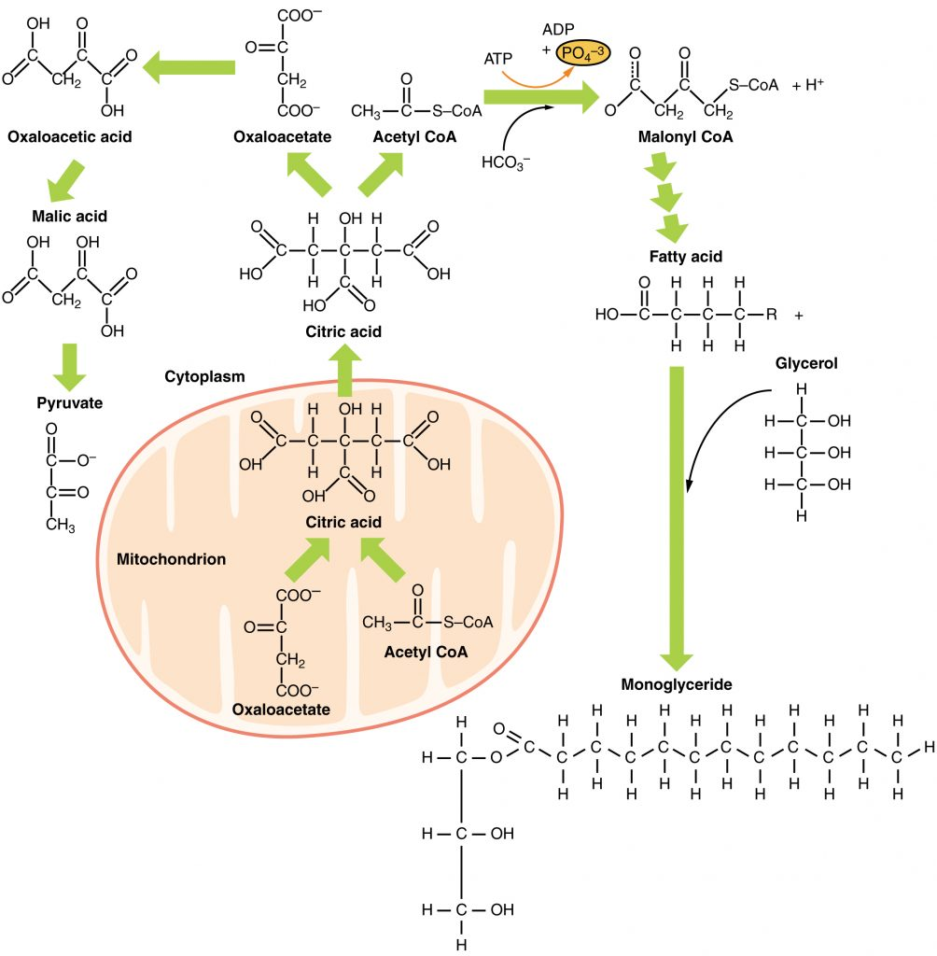

Slide 7
Lipolysis
During fasting or stress, fatty acids can be activated in the liver to undergo B-oxidation. This occurs in the mitochondria and produces acetyl-CoA which can either enter the TCA cycle or be used to produce ketone bodies.
The long chains of fatty acids are broken down into a series of 2 carbon acetate units, which are then combined with co-enzyme A to form acetyl-CoA. This acetyl-CoA can then be combined with oxaloacetate to form citrate for the beginning of the TCA cycle.
Glucagon and adrenaline stimulate the process of lipolysis whereas it is inhibited by insulin.

Slide 8
Protein Metabolism
Protein Synthesis
Proteins can be synthesised in the liver using amino acids consumed in the diet.
Protein synthesis is stimulated by insulin and growth hormone.
The following are synthesised within the liver:
Albumin
CRP (an infection marker)
Blood clotting factors – Factors II, VII, IX and X are Vitamin K dependent
Thrombopoietin
Angiotensinogen

Slide 9
Protein Catabolism
The liver has an important role in the catabolism of excess amino acids consumed in the diet (i.e amino acids which are not needed for the synthesis of proteins or nitrogen-compounds).
They are metabolised in the liver but the amino group is potentially toxic and must be removed.
One option is transamination, where the amino group can be transferred to ketoacids through the actions of alanine aminotransferase (ALT) and aspartate aminotransferase (AST)

Slide 10
The amino group can be added to alpha-ketoglutarate to form glutamate
The amino group can be added to oxaloacetate to form aspartate
The amino group can be removed from an amino acid to produce a ketoacid and ammonia, via deamination. This uses high-specificity glutaminase, or low-specificity L+D amino-acid oxidase enzymes.
The ammonia is then converted to an ammonium ion, which must be removed due to toxicity.
It can be removed via glutamine or the urea cycle.

Slide 11
Ammonia Metabolism
Ammonium ions are produced during amino acid degradation and blood concentration is typically low due to their toxicity.
Ammonia is toxic to cells as it reduces TCA cycle activity, affects neurotransmitter synthesis and creates an alkaline pH.
Detoxification occurs in two steps, firstly ammonia is used to synthesise glutamine when combined with glutamate.
Glutamine can then be used to synthesise nitrogen compounds such as purines and pyramidines.
It is either then transported to the kidney, where the ammonia is directly excreted, or to the liver where it is used to make urea.
The urea can then also be transported to the kidneys where the ammonia can be directly excreted in urine.

Slide 12
Vitamin Metabolism
The liver is important in the metabolic activation of Vitamin D. It is carried to the liver in the blood where it is first converted to the prohormone calcifediol via hydroxylation. This calcifediol is then transported to the kidneys where it is converted into calcitriol, the biologically active form of Vitamin D.
The conversion of calcifediol to calcitriol is catalysed by 25-hydroxyvitamin D3 1-alpha-hydroxylase. This conversion is stimulated by parathyroid hormone and low calcium.

Slide 13
Thank you

